Slide 1
ICEG Interoperability Training
MS Teams (120min)
4 december 2020
#beinterop
start at 10:00

Slide 2
Agreements
Audience is muted and webcam is turned off.
Questions, comments or suggestions can be shared via the chat function of MS Teams.
→ Interaction is encouraged!
+1 of -1
A yes/no question can be answered simply and quickly via chat: Agree= +1 Disagree= -1

Slide 3
What are your expectations?
(reply via chat)

Slide 4
Agenda
10:00 - 10:50 - plenary
Introduction by Seth Van Hooland 10’
IOP Concepts 30’
Example case: CPSV-AP 10’
10:50 - 11:00
BREAK ‘10
11:00 - 11:45 - break-out
Case Saint Nicholas 45’
11:45 - 12:00 - plenary
Wrap-up

Slide 5


10:00 - 10:50 - Plenary
Introduction by Seth Van Hooland
IOP Concepts

Slide 6
Introduction ISA EC (10’)
[ by Seth Van Hooland ]
Context
Why important
Initiatives ISA/semic (core vocabularies, ..)
SDG

Slide 7
IOP Concepts (30’)
Interoperability
EIF
Semantic IOP (ISA core voc)
Technical IOP (the web as a blueprint + URI standard)
Governance (ICEG process and method)
Tooling (JSON-LD and SHACL-validator)

Slide 8

Interoperabiliteit
De mogelijkheid van verschillende autonome organisaties of systemen om met elkaar te communiceren en samen te werken.

Slide 9
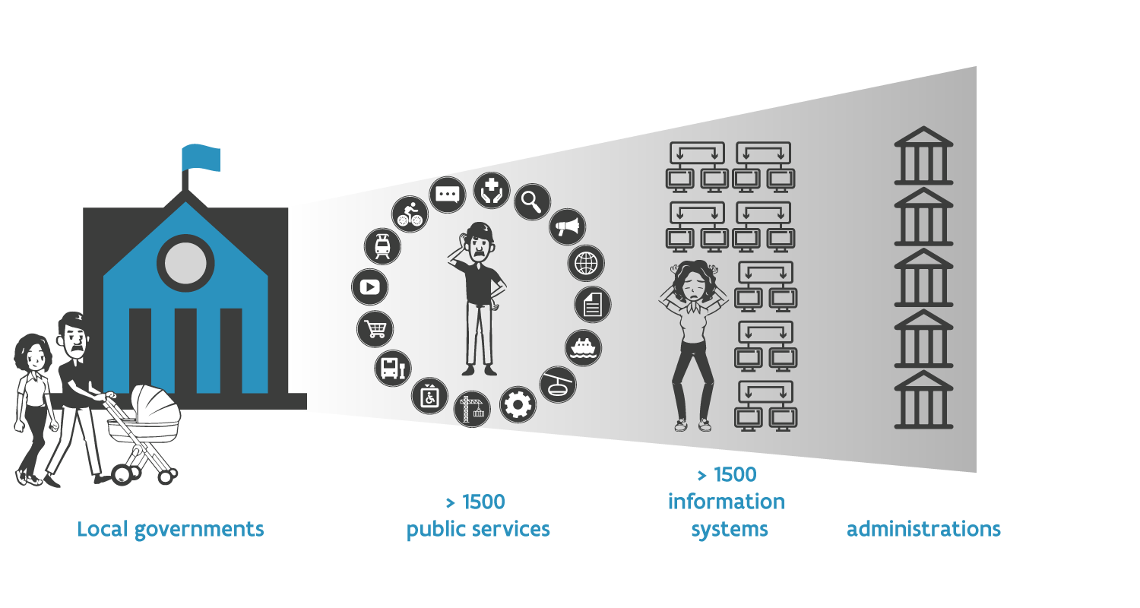
Interoperabiliteit: Waarom belangrijk?
> 1000 publieke
diensten
> 250 informatie- systemen
> 1500 publieke administraties
Lokale overheid

Slide 10
Interoperabiliteit: 4 niveaus
verwijst naar gealigneerde wetgeving tussen
verschillende organisaties en beleidsdomeinen
Legale interoperabiliteit
Organisationele interoperabiliteit
afstemmen van businessprocessen tussen verschillende administraties en beleidsdomeinen
focust op
de betekenis van data-elementen
Semantische interoperabiliteit
Technische interoperabiliteit
heeft betrekking tot de
verschillende protocollen, formaten en interfaces

Slide 11
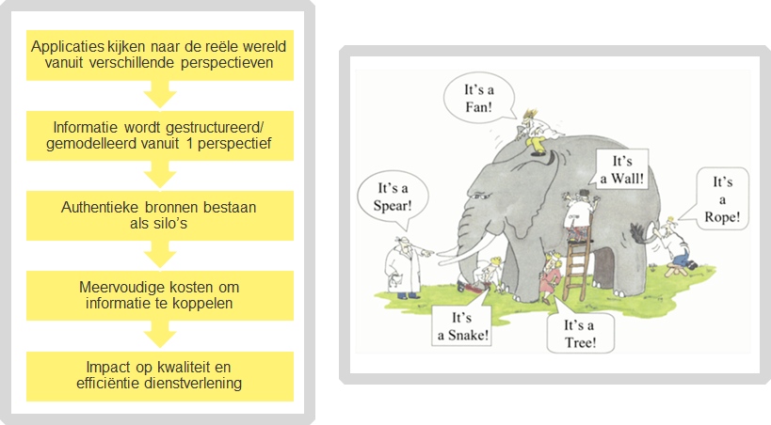
Semantische interoperabiliteit

Slide 12
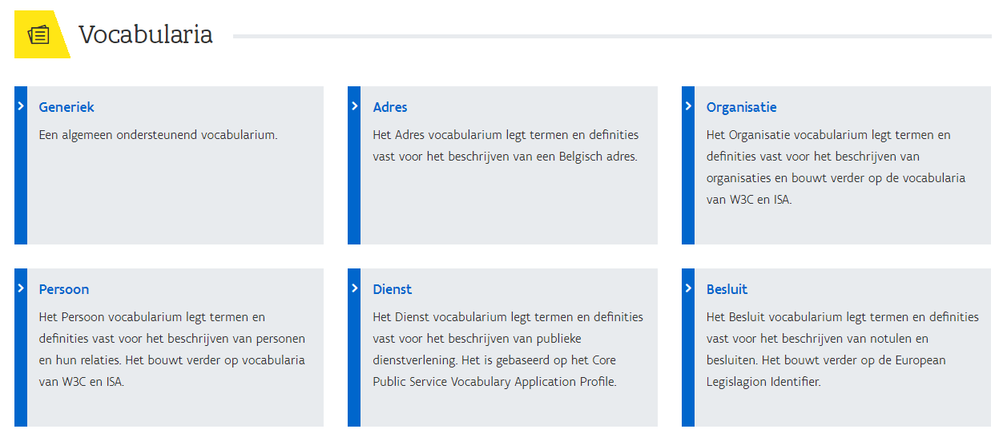
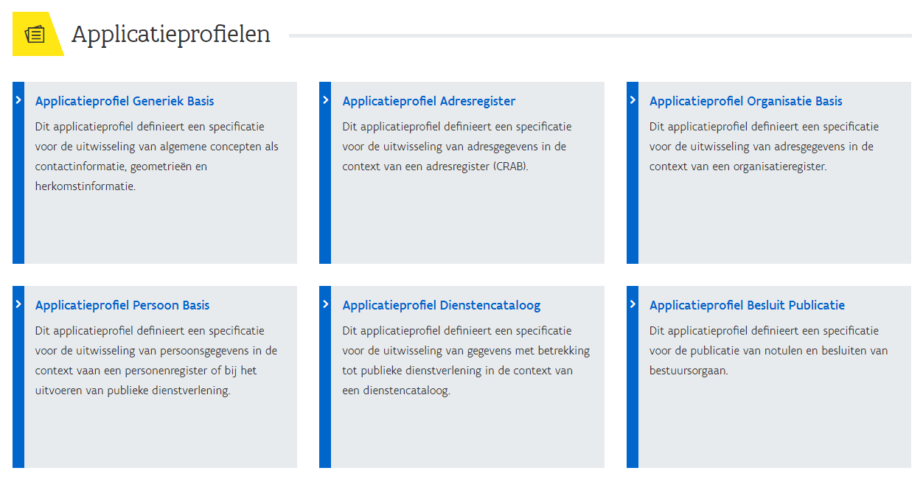
Semantische interoperabiliteit
Voorbeelden vocabularia:
Persoon
Adres
Organisatie
Dienst
Besluit
Bestuur
Mandaat
Melding
Notificatie
Subsidie
Toestemming
Dienst-Transactie
Weg
Wetgeving
Gebouw
Openbaar Domein
Mobiliteit
Logies
https://data.vlaanderen.be/ns/

Slide 13
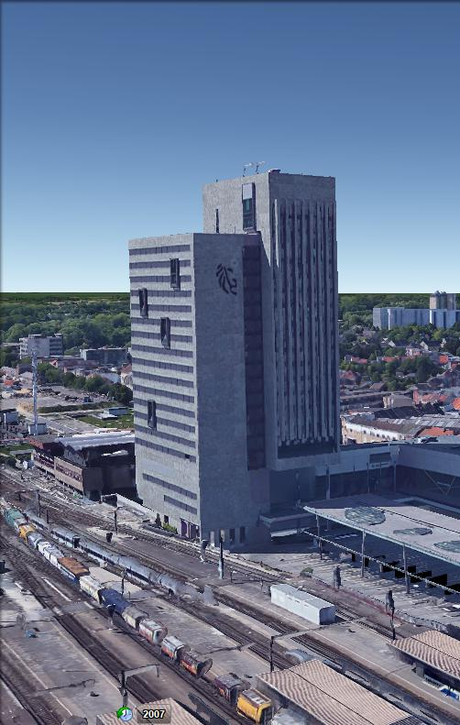
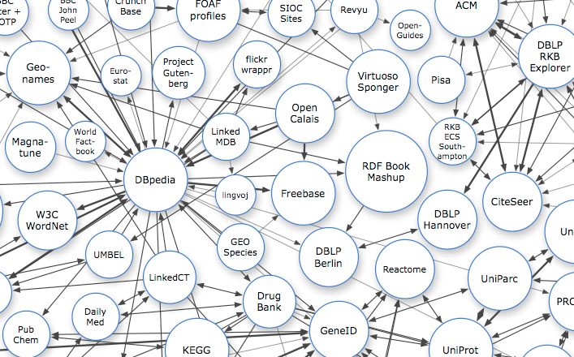
Technische interoperabiliteit: Het web als blauwdruk
Persistente Identificatoren: URIs
Dereferencieerbare HTTP URIs
Gestandaardiseerde Informatie (RDF)
Links naar andere informatie

Slide 14


Technische interoperabiliteit: Het web als blauwdruk
Persistente Identificatoren: URIs
http://data.vlaanderen.be/id/adres/3706808
Koningin Maria Hendrikaplein 70,
9000 Gent
Dereferencieerbare HTTP URIs
Gestandaardiseerde Informatie (RDF)
Links naar andere informatie

Slide 15
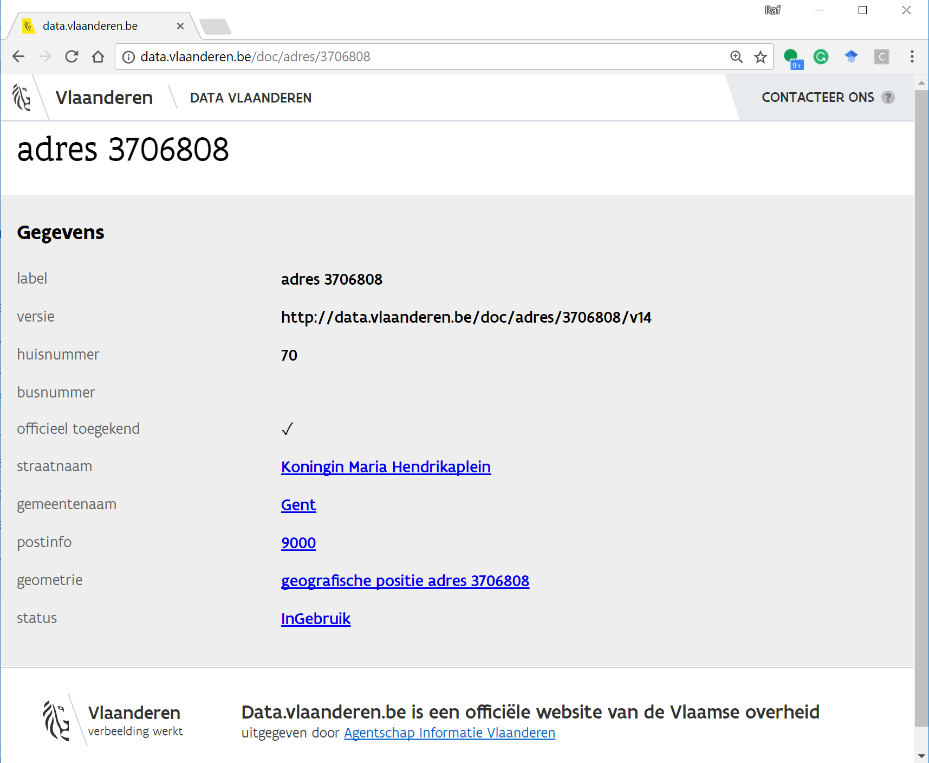
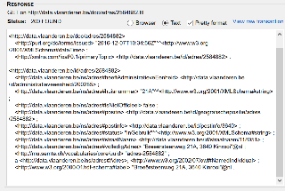
Technische interoperabiliteit: Het web als blauwdruk
Persistente Identificatoren: URIs
Dereferencieerbare HTTP URIs
http://data.vlaanderen.be/id/adres/3706808
Gestandaardiseerde Informatie (RDF)
Links naar andere informatie
Mensleesbaar
Computerleesbaar

Slide 16
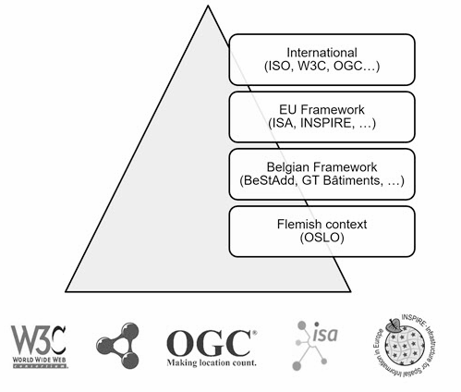
Technische interoperabiliteit: Het web als blauwdruk
Persistente Identificatoren: URIs
Dereferencieerbare HTTP URIs
Gestandaardiseerde Informatie (RDF)
http://data.vlaanderen.be/ns/adres
https://www.w3.org/ns/locn#adminUnitL2
Links naar andere informatie

Slide 17
Technische interoperabiliteit: Het web als blauwdruk
Persistente Identificatoren: URIs
Dereferencieerbare HTTP URIs
Gestandaardiseerde Informatie (RDF)
Links naar andere informatie
data.vlaanderen.be/id/organisatie/OVO002949
Agentschap Informatie Vlaanderen
http://data.vlaanderen.be/id/adres/3706808
Koningin Maria Hendrikaplein 70
9000 Gent

Slide 18
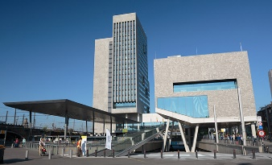

Technische interoperabiliteit: URI’s
VO:Gebouw:2132
Identificator 2132
https://data.vlaanderen.be/id/gebouw/2132
By saving a reference
By taking over all the data
{
“buildingName”: “VAC GENT”,
“buildingYear”: “2010”,
“E-level” : “50”,
“address”: “Maria Hendrikaplein 90”
…
}
time

Slide 19
Governance: ICEG proces en methode
Schaalbaar proces voor het aanmelden, ontwikkelen, wijzigen en uitfaseren van datastandaarden.

Slide 20
Semantic Data
API’s

Slide 21
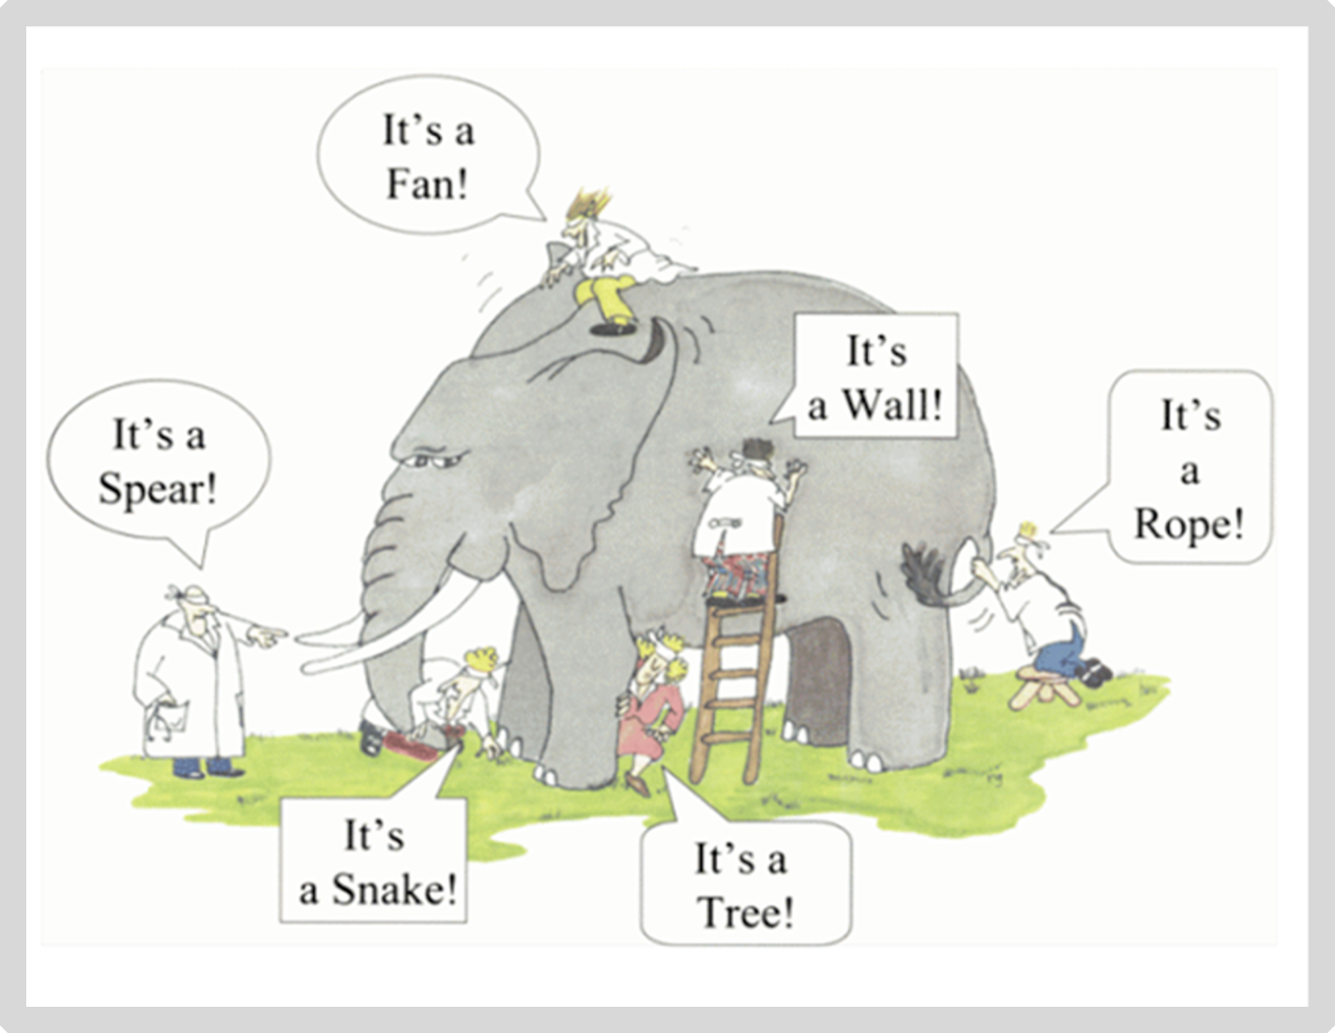
It’s all about the context

Slide 22
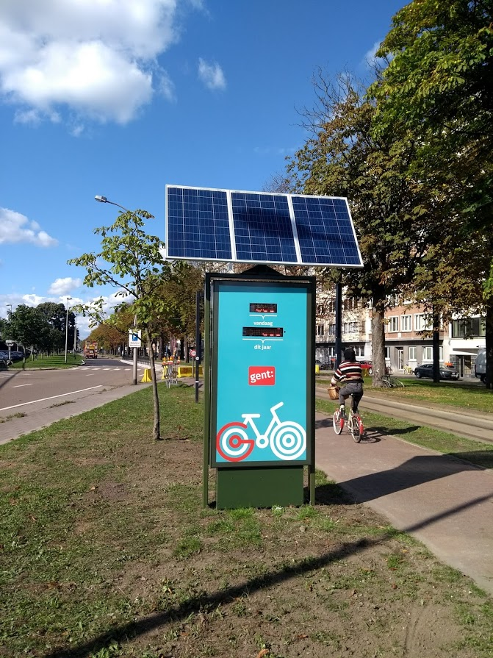
I want to exchange data
JSON
{
“Fietsteller-Zuid” : {
“type” : “BicycleCounter”,
“city” : “Ghent”,
“today” : “100”
}
}

Slide 23
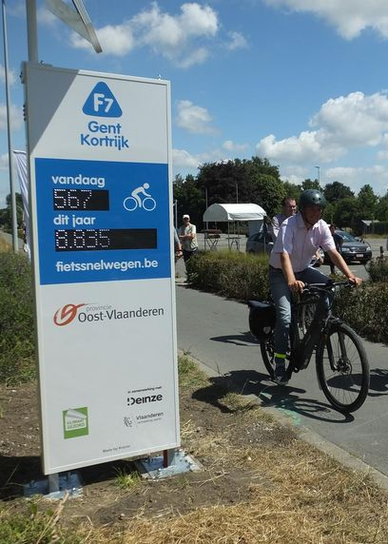
But how do we understand each other?
JSON
{
“Fietsteller-Zuid” : {
“type” : “BicycleCounter”,
“city” : “Ghent”,
“today” : “100”
}
}
Table / CSV / Spreadsheet
name | type | location | number
F7 Gent-Kortrijk | BikePassageCounter | Waregem | 250

Slide 24
We know, but machines don’t
<Fietsteller-Zuid> <type> <BicycleCounter>
<Fietsteller-F7> <type> <BikePassageCounter>
<Fietsteller-Zuid> <today> <100>
<Fietsteller-F7> <number> <250>
→ BicycleCounter is the same as a BikePassageCounter
→ Number basically means the same as today in this context

Slide 25
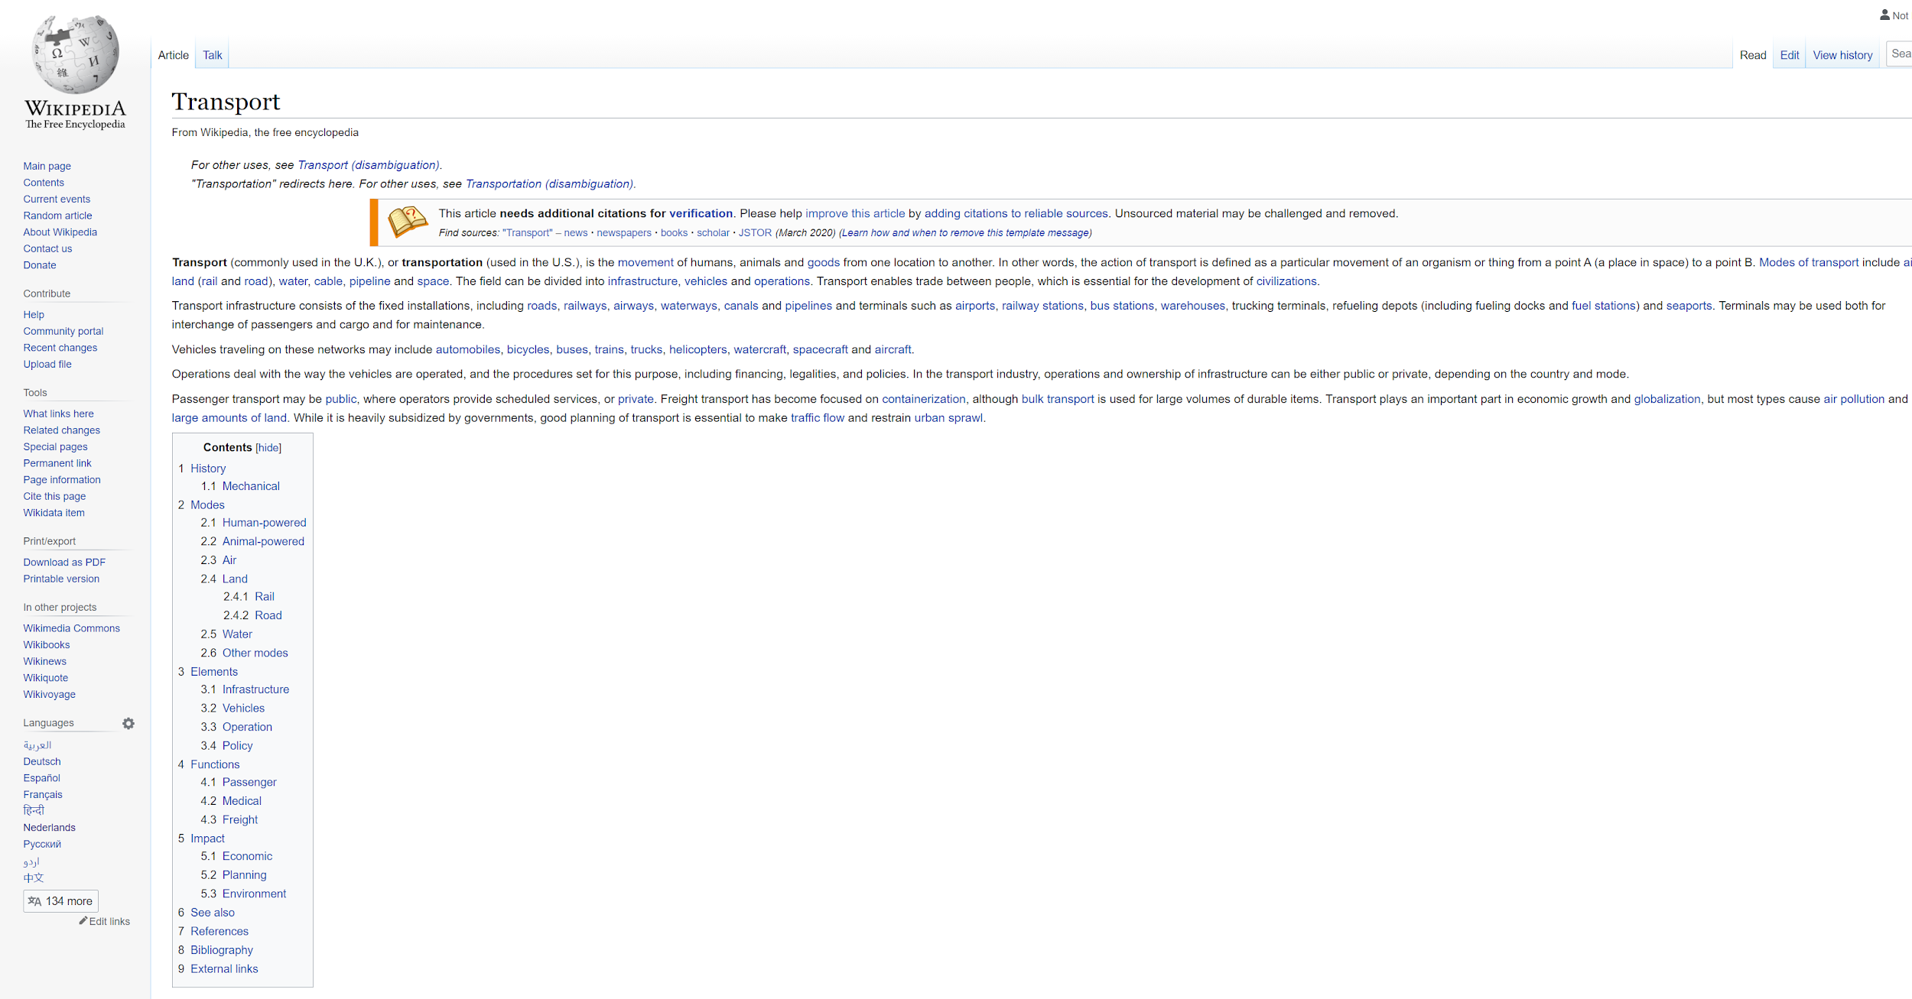
Solved by using URIs*
<Fietsteller-Zuid> <type> <BicycleCounter>
<Fietsteller-F7> <type> <BikePassageCounter>
<Fietsteller-Zuid> <today> <100>
<Fietsteller-F7> <number> <250>
https://wikipedia.org/BikeCounter
But machines only get a human readable description (HTML)
URI = Uniform Resource Identifier
Notes:
Uitleggen dat als URI’s we ook konden gekozen hebben voor ISBN nummers omdat die over gans de wereld een boek uniek identificeren, maar dat die niet dereferencieerbaar zijn.
We gebruiken daarom de kracht van het Web en kiezen voor URL’s als URI’s

Slide 26
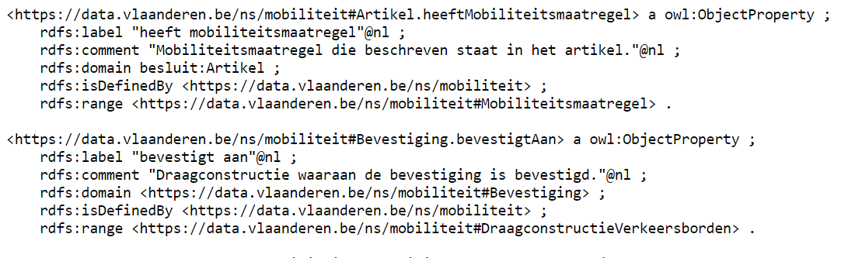
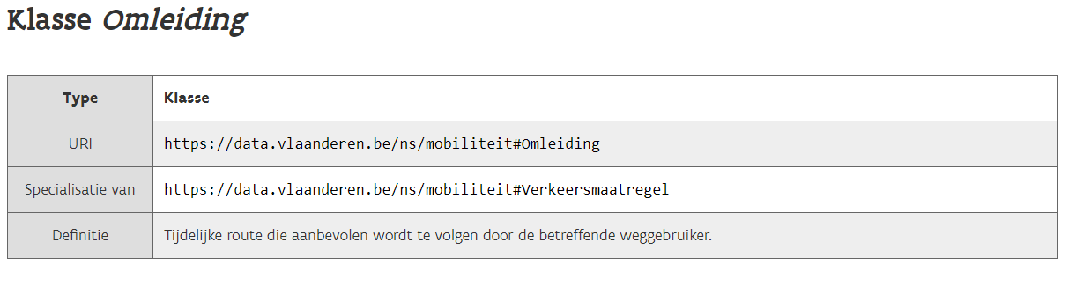
We use URIs that provide both a human and machine readable description
<Fietsteller-Zuid> <type> <BicycleCounter>
<Fietsteller-F7> <type> <BikePassageCounter>
<Fietsteller-Zuid> <today> <100>
<Fietsteller-F7> <number> <250>
https://data.vlaanderen.be/ns/example#BikeCounter
Human readable
Machine readable

Slide 27
Applying context and URIs to our example, creating JSON-LD
{
“@context” : {
“BicycleCounter” : “https://data.vlaanderen.be/ns/example#BikeCounter”
“today” : “https://data.vlaanderen.be/ns/example#totalNumberOfBicycles”
},
“@id” : “https://example.org/id/Fietsteller-Zuid”,
“@type” : “BicycleCounter”,
“today” : 100
}
{
“@context” : {
“BikePassageCounter” : “https://data.vlaanderen.be/ns/example#BikeCounter”
“number” : “https://data.vlaanderen.be/ns/example#totalNumberOfBicycles”
},
“@id” : “https://example.org/id/Fietsteller-F7”,
“@type” : “BikePassageCounter”,
“number” : 250
}

Slide 28
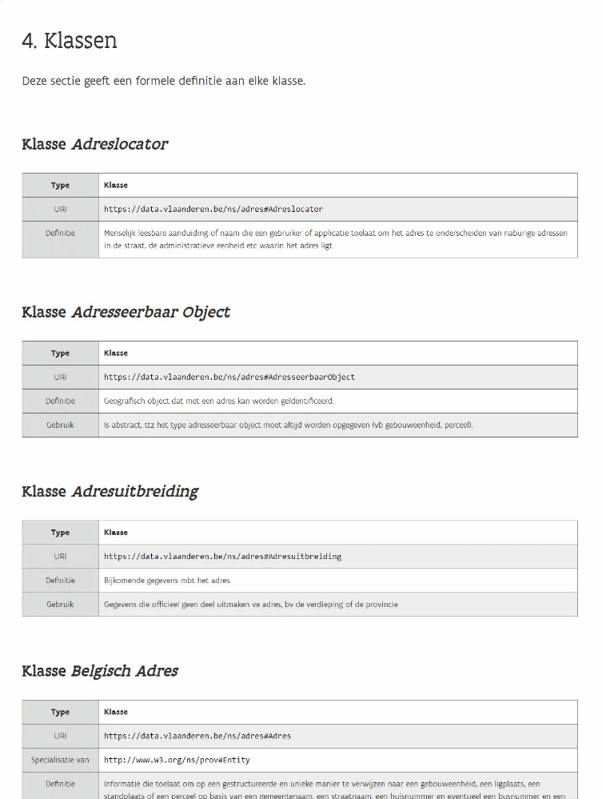
Vocabularies & Application Profiles
Vocabularies contain a list of terms
per domain
→ For example: address, organization, person, ...
Notes:
Create gif?

Slide 29
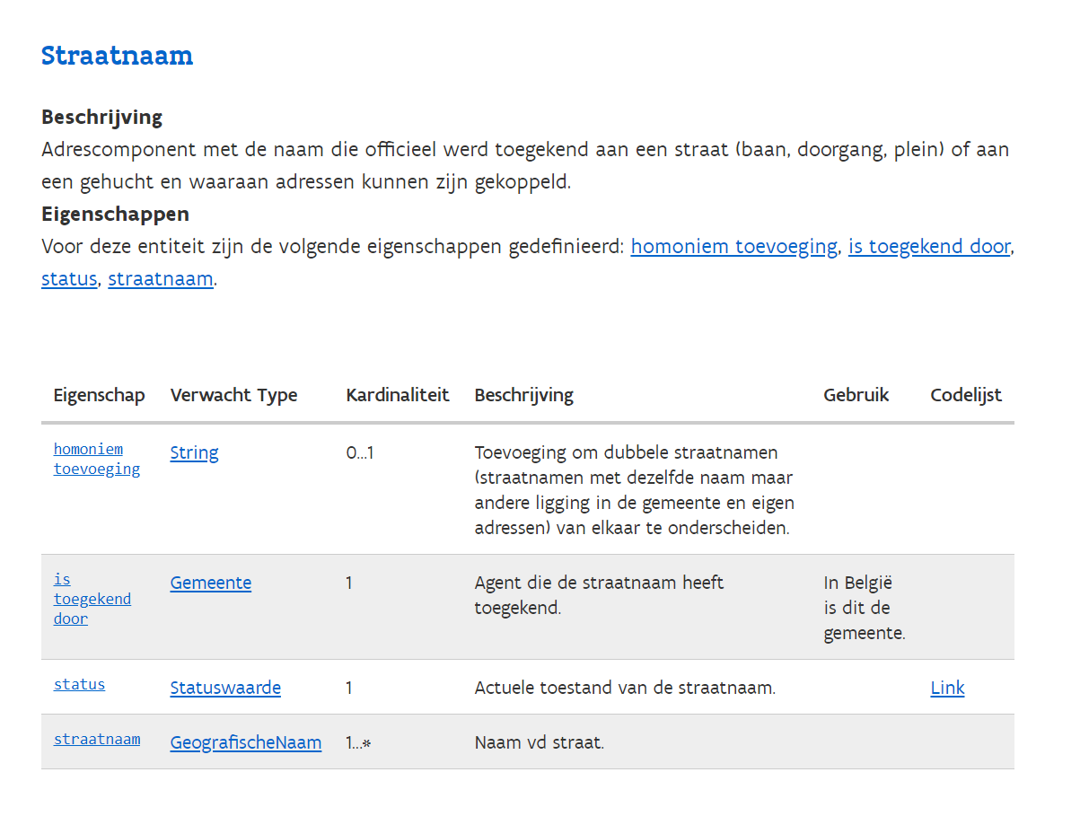
Vocabularies & Application Profiles
Application profiles determine which
data must be exchanged
→ For example: a street name
Notes:
Create gif?

Slide 30
Semantic Data
APIs

Slide 31
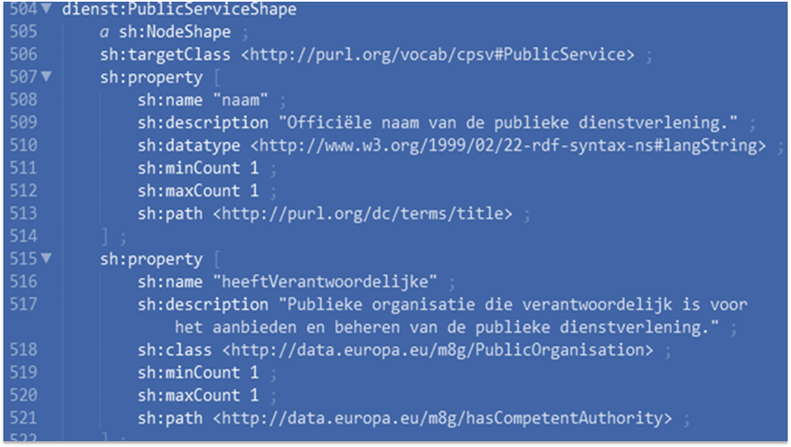
I have an API that publishes semantic data
Is my data in line with these standards? (compliance)
→ Technical contracts as SHACL* ensure this.
A document with a set of conditions
SHACL = Shapes Constraints Language

Slide 32

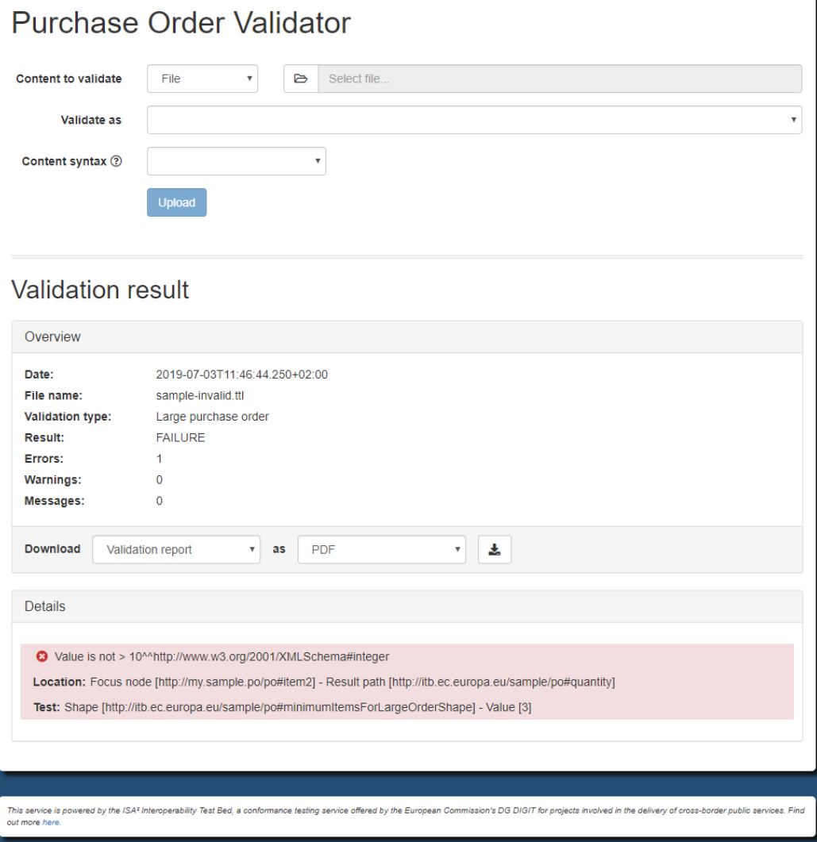
Tooling: SHACL-validator
Europe provides tools to do this automatically: RDF validator
Frontend
REST API
SOAP API
Flanders built its own frontend on top of the EU backend

Slide 33
Tooling: SHACL-validator
https://data.vlaanderen.be/shacl-validator/
Notes:
TODO: add clip of SHACL validator

Slide 34

Example case: CPSV-AP
High level CPSV-AP
Example subsidie besluit

Slide 35
Plenair instructie geven

Slide 36



11:00 - 11:45 - Case “Saint Nicholas”
Illustration of the case
5 break-out rooms

Slide 37
Purpose of the exercise
Get familiar with (building) implementation models

Slide 38
5 break-out rooms
[NL] - Liesbet | [FR] - Thierry | [FR] - Olivier-Pascal | [ENG] - Raf | [ENG] - Dwight | [ENG] - Eveline

Slide 39

Timeline exercise (45’)
Step 1: Define use case (5’)
Intro (5’)
Step 2: List and inventarize concepts (10')
Intro (2')
Execute (8')
Step 3: Look for existing voc’s and AP’s (10')
Intro (2')
Execute (8')
Step 4: Map your concepts (5')
Intro (2')
Execute (3')
Step 5: Find a solution for unmapped concepts (5')
Intro (5')
Step 6: Establish an implementation model (10')
Intro (10')
Notes:
Case beantwoord een prangend probleem uit de organisatie.

Slide 40
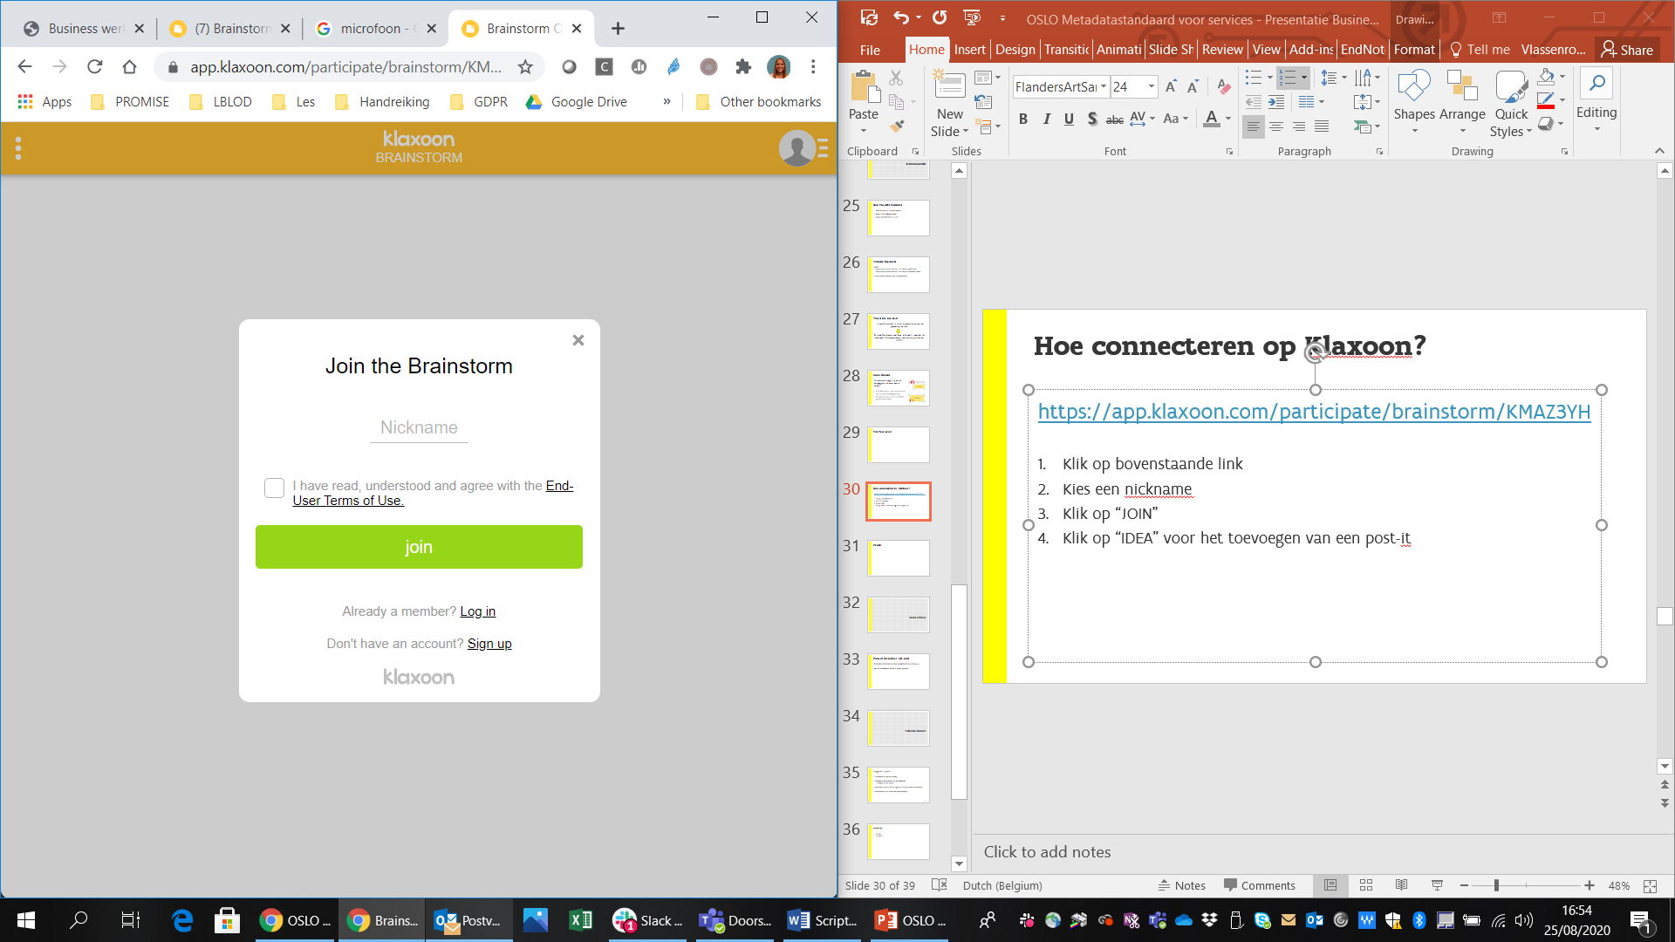
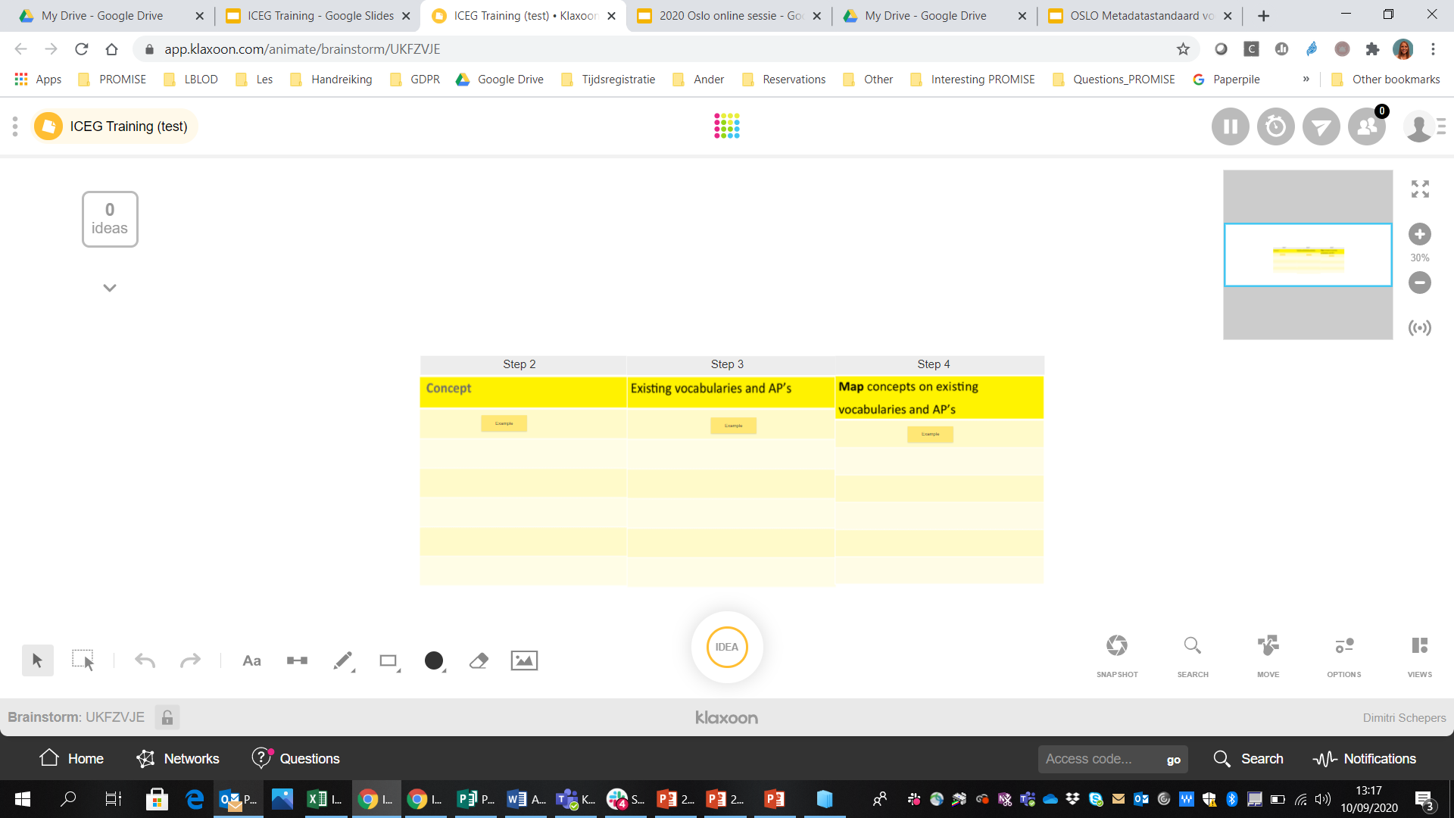
How to connect to Klaxoon?
https://app.klaxoon.com/animate/brainstorm/UKFZVJE
Klik op bovenstaande link
Kies een nickname
Klik op “JOIN”
Klik op “IDEA” voor het
toevoegen van een post-it
Notes:
Move nog toevoegen

Slide 41



Slide 42
1. Define use case
2. List and inventarize relevant concepts
3. Study and look for existing vocabularies and AP’s
4. Map your concepts on the existing vocabularies and AP’s
5. Find a solution for unmapped concepts
6. Establish an implementation model

Slide 43
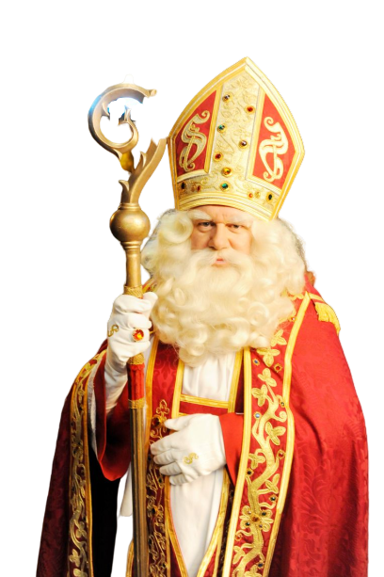
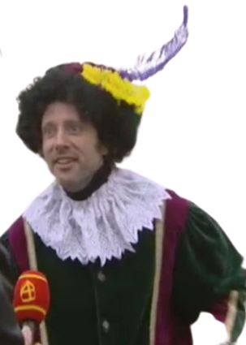

Step 1: Define use case
Purchase management
Budget management
Logistic planning so that all gifts are delivered on time
Pass on wish list
Receive a gift

Slide 44
1. Define use case
2. List and inventarize relevant concepts
3. Study and look for existing vocabularies and AP’s
4. Map your concepts on the existing vocabularies and AP’s
5. Find a solution for unmapped concepts
6. Establish an implementation model

Slide 45
Step 2: List and inventarize relevant concepts
List the (information)concepts needed to implement the use cases.

Slide 46
Step 2: List and inventarize relevant concepts [TEMPLATE]
Concept
Concept 1
Concept 2
Concept 3
Concept 4
Concept 5
…

Slide 47
Step 2: List and inventarize relevant concepts [SOLUTION]
Wenslijst opstellen: Brief, Karaktertrekken, Cadeaus
Cadeau in ontvangst nemen: Persoonsgegevens, Leveradres
Aankoopbeheer: Leverancier, Prijs
Budgetbeheer: Prijs, Betaling
Logistiek: Afhaaladres, Leveradres, Piet, Paard, Schoorsteen

Slide 48
Step 2: List and inventarize relevant concepts [SOLUTION]
Concept
Brief
Karaktertrekken
Cadeaus
Persoonsgegevens
Leveradres
Leverancier
Prijs
Betaling
Afhaaladres
Piet
Paard
Schoorsteen

Slide 49
1. Define use case
2. List and inventarize relevant concepts
3. Study and look for existing vocabularies and AP’s
4. Map your concepts on the existing vocabularies and AP’s
5. Find a solution for unmapped concepts
6. Establish an implementation model

Slide 50
Step 3: Look for existing vocabularies and AP’s
Browse to data.vlaanderen.be/ns where you can view the existing OSLO vocabularies and application profiles.
Explore the AP’s and see what you find interesting, eg: “Persoon Basis”, “Organisatie”, “Dienstencataloog”, ..
Click on the classes to jump to the vocabulary.
Write down the classes (eg. “Adres”, “Persoon”, “Organisatie”) that are relevant and reusable for this case.

Slide 51
Step 3: Look for existing vocabularies and AP’s [SOLUTION]
We can use the following existing (OSLO) classes:
OSLO klasse 1: Persoon
OSLO klasse 2: Adres
OSLO klasse 3: Document
OSLO klasse 4: Geldbedrag
OSLO klasse 5: Object
OSLO klasse 6: Geregistreerde organisatie

Slide 52
1. Define use case
2. List and inventarize relevant concepts
3. Study and look for existing vocabularies and AP’s
4. Map your concepts on the existing vocabularies and AP’s
5. Find a solution for unmapped concepts
6. Establish an implementation model

Slide 53
Step 4: Map your concepts on existing vocabularies and AP’s
Put the necessary concepts (identified in step 2) next to the existing OSLO classes (step 3) to identify the differences and similarities.
Provide a mapping value (SKOS) to the overlap:
Exact match
Related match
Broad match
Narrow match
No match
OSLO klasse 3: Document
OSLO klasse 4: Geldbedrag
OSLO klasse 5: Object
OSLO klasse 6: Geregistreerde organisatie

Slide 54
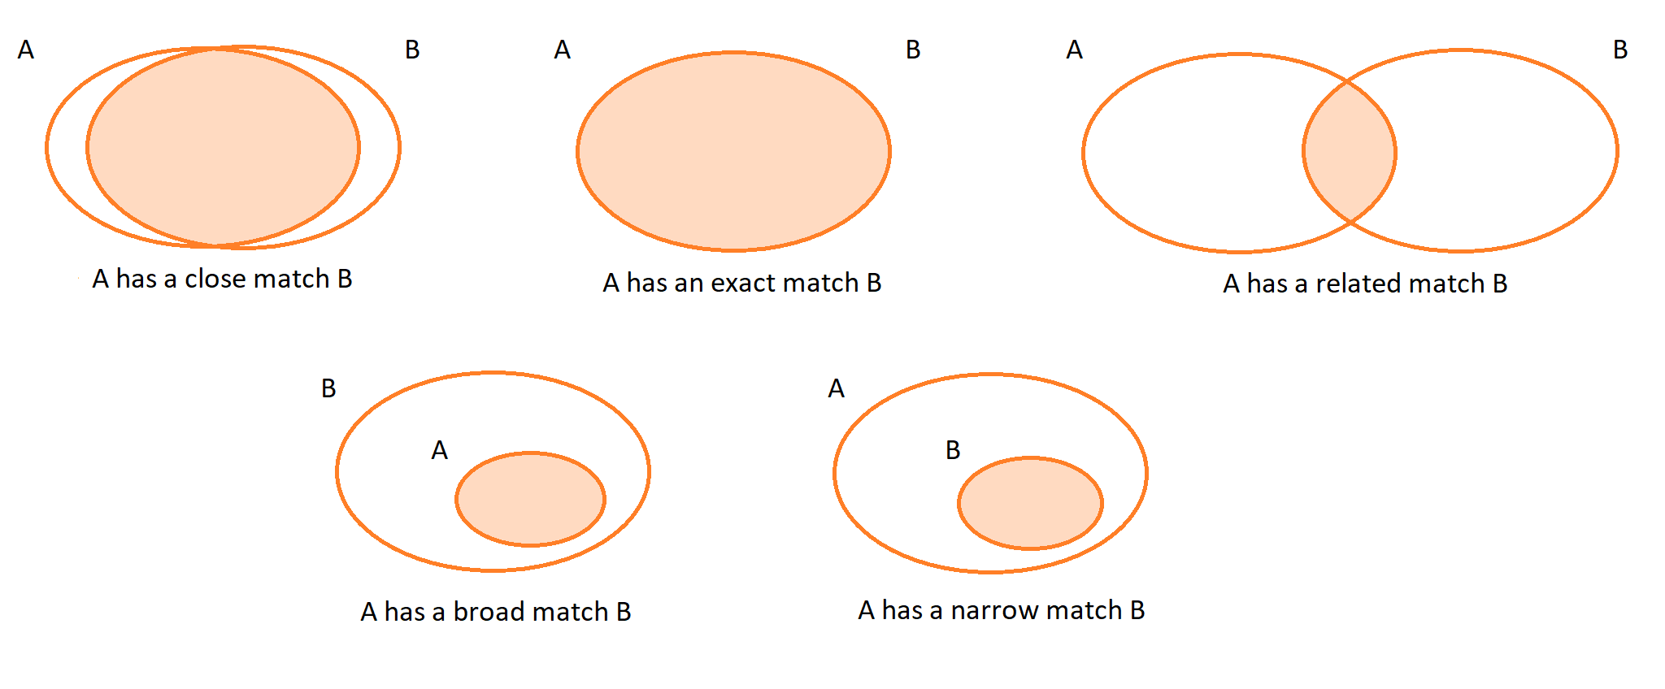
Step 4: SKOS mapping

Slide 55
Step 4: Map on existing voc’s and AP’s [TEMPLATE]
Concept | OSLO Klasse | Mapping
Concept 1 | OSLO-Voc1::Klasse1 | Exact match
Concept 2 | OSLO-Voc1::Klasse2 | Narrow match
Concept 3 | ??? | No match
Concept 4 | OSLO-Voc2::Klasse3 | Related match
Concept 5 | OSLO-Voc3::Klasse4 | Broad match
…

Slide 56
Step 4: Map on existing voc’s and AP’s [SOLUTION]
Concept | OSLO Concept | SKOS mapping
Brief | OSLO-Generiek::Document | Narrow match
Karaktertrekken | ???
Cadeaus | ???
Persoonsgegevens | OSLO-Persoon::Persoon | Exact match
Leveradres | OSLO-Adres | Narrow match
Leverancier | OSLO-Organisatie::GeregistreerdeOrganisatie | Related match
Prijs | OSLO-Generiek::Geldbedrag | Close match
Betaling | ???
Afhaaladres | OSLO-Adres::Adres | Narrow match
Piet | OSLO-Persoon::Persoon | Narrow match
Paard | ???
Schoorsteen | OSLO-Generiek::Object | Narrow match

Slide 57
1. Define use case
2. List and inventarize relevant concepts
3. Study and look for existing vocabularies and AP’s
4. Map your concepts on the existing vocabularies and AP’s
5. Find a solution for unmapped concepts
6. Establish an implementation model

Slide 58
Step 5: Find a solution for unmapped concepts
Look at international standards and vocabularies.
tip: https://lov.linkeddata.es/
DC terms
schema.org
dbpedia.org
Legislation and other official documents at Flemish, Belgian and European level.
Models that are already in use by other public administrations in Flanders, Belgium or Europe. An example is the INSPIRE data models.

Slide 59
Step 5: Some more tips
Check whether there are already international data standards that define the necessary.
Only in last instance define something completely yourself.
For these new entities:
Check whether these are also relevant in a different context, for other parties, in the context of information exchange and whether an alignment process should be started around this.
For things that don’t seem to match completely:
See if your information model cannot be adjusted.
If not: OSLO and other data standards can be changed. Feel free to send a comment!
If alignment is not possible in one of these 2 ways, please rename it.

Slide 60
Step 5: Find a solution for unmapped concepts [TEMPLATE]
Concept | Gemapct | Mapping
Concept 1 | OSLO-Voc1::Concept1 | Exact match
Concept 2 | OSLO-Voc1::Concept2 | Narrow match
Concept 3 | PROV-O::Concept1 | Exact match
Concept 4 | OSLO-Voc2::Concept3 | Related match
Concept 5 | OSLO-Voc3::Concept4 | Broad match

Slide 61
Step 5: Find a solution for unmapped concepts [SOLUTION]
Concept | OSLO Concept | SKOS mapping
Brief | OSLO-Generiek::Document | Narrow match
Karaktertrekken | ??? | No match
Cadeaus | ??? | No match
Persoonsgegevens | OSLO-Persoon::Persoon | Exact match
Leveradres | OSLO-Adres | Narrow match
Leverancier | OSLO-Organisatie::GeregistreerdeOrganisatie | Related match
Prijs | OSLO-Generiek::Geldbedrag | Close match
Betaling | http://reference.data.gov.uk/def/payment#Payment | Exact match
Afhaaladres | OSLO-Adres::Adres | Narrow match
Piet | OSLO-Persoon::Persoon | Narrow match
Paard | http://dbpedia.org/ontology/Horse | Exact match
Schoorsteen | OSLO-Generiek::Object | Narrow match

Slide 62
1. Define use case
2. List and inventarize relevant concepts
3. Study and look for existing vocabularies and AP’s
4. Map your concepts on the existing vocabularies and AP’s
5. Find a solution for unmapped concepts
6. Establish an implementation model

Slide 63
Step 6: Establish an implementation model
Add attributes to the model.
Add relationships to the model.
Add restrictions to the model.
(Make definitions more concrete).

Slide 64
Step 6: Establish an implementation model [TEMPLATE]
Concept 1
Concept 2
- Attribuut 1
- Attribuut 2 - Attribuut 3
- Attribuut 1
- Attribuut 2 - Attribuut 3
relatie 1 🡪
Subconcept 3
- Attribuut 1
- Attribuut 2 - Attribuut 3

Slide 65
Step 6: Establish an implementation model [SOLUTION]
OSLO::Publieke Dienstverlening
Pakjesavond
OSLO::Persoon
OSLO::Adres
- voornaam: tekst [1]
- achternaam: tekst [1]
woont op ▶
- beschrijving: tekst [0..1]
- land [1] - gemeente [1]
- straatnaam [1]
- huisnummer [1]
- busnummer [0..1]
- schoorsteenAanwezig [0..1]
heeft verantw. ▶
Sinterklaas
Piet
Kind
- leeftijd: getal [0..1] - stout: ja/nee [1]
▲ heeft maatsch. zetel
heeft uitvoerder ▶
▲ heeft magazijn
Prijs
OSLO::Object OSLO::Output
Cadeau
◀ wilt
- waarde [1]
- valuta [1]
OSLO::Organisatie
Leverancier
produceert ▶
- fabrikant [0..1]
- model [0..1]
- beschrijving [0..1]
- naam [1]
- registratienummer [1]
aangeboden door ▶

Slide 67
11:45 - 12:00 - Wrap-up
[ Future trainings for C-level and for developers ]
[ Other upcoming initiatives ]
Feedback - meet the expectations

Slide 68
Thank you!

